Slide 1


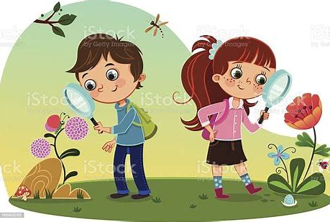
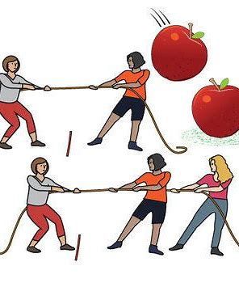





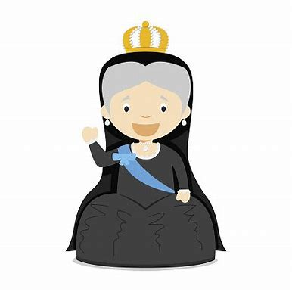




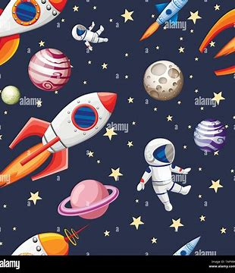


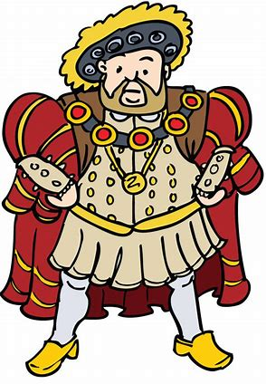











The Oaks Federation Theme Map
Nursery/Reception
Nursery/Reception
Nursery/Reception
Autumn
Cycle 1: My World
Cycle 2: Twinkle, Twinkle
Spring
Cycle 1: Animal Magic
Cycle 2: Once Upon A Time
Summer
Cycle 1: Summer Sensation
Cycle 2: If You go down to the Woods
Expressive Arts
Health & Wellbeing
Year 1 and 2
Year 1 and 2
Year 1 and 2
Summer
Cycle 1: Splish, Splash, Splosh
Cycle 2: All Our Yesterdays
Spring
Cycle 1: Changes
Cycle 2: Planes, Trains, Automobiles
Autumn
Cycle 1: Amazing Me! Cycle 2: Out & About
Humanities
Language, Literacy & Communication
Year 3 and 4
Year 3 and 4
Year 3 and 4
Autumn
Cycle 1: Globe Trotting
Cycle 2: Wonderful World
Spring
Cycle 1: Exploration and Discovery
Cycle 2: In Ancient Times
Summer
Cycle 1: Blue Planet
Cycle 2: Bright Sparks
Mathematics & Numeracy
Science and Technology
Year 5 and 6
Year 5 and 6
Year 5 and 6
Summer
Cycle 1: Me, Myself and I
Cycle 2: May the force be with You
Spring
Cycle 1: Power of People
Cycle 2: Our heritage
Autumn
Cycle 1: The World at War
Cycle 2: Infinity and Beyond

