Slide 1

Cyber shield newspaper.
Internet safety
By Livvy And Brooklyn.
This presentation is about keeping you safe on the internet.

Slide 2
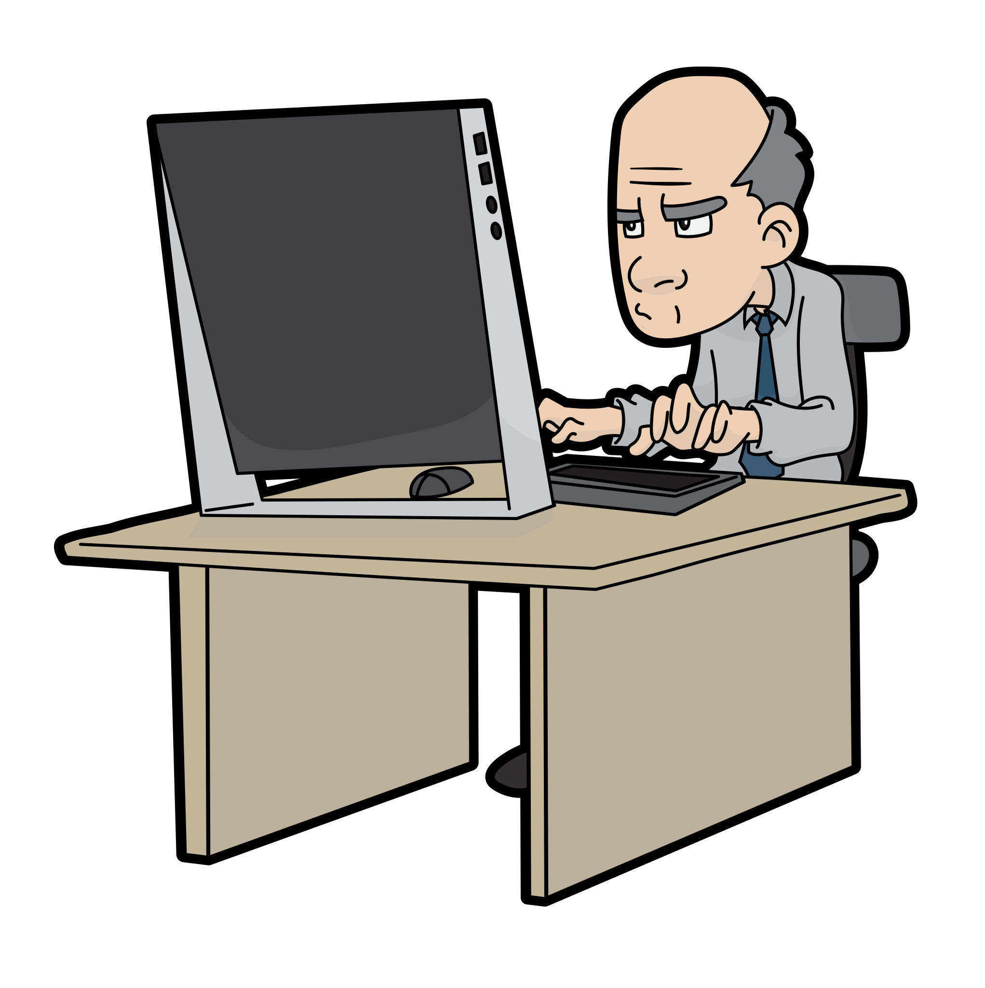
Talking to people.
.
You
Never
know!
Don’t chat to random
Strangers
Because they can be your grandad or a child predator.
This is who you could be talking to.

Slide 3
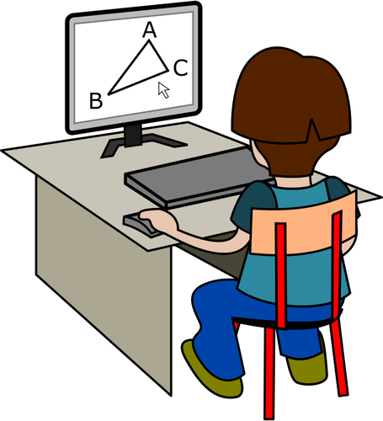
The next slide could be an example of adult predators.
V
The next slide we will be showing you will be an example of adult predators trying to find their victim online.
PS:
___________
Don’t talk to random strangers online because this could happen to you.
____________________________________
Don’t risk
It for your own safety guys!!!!

Slide 4
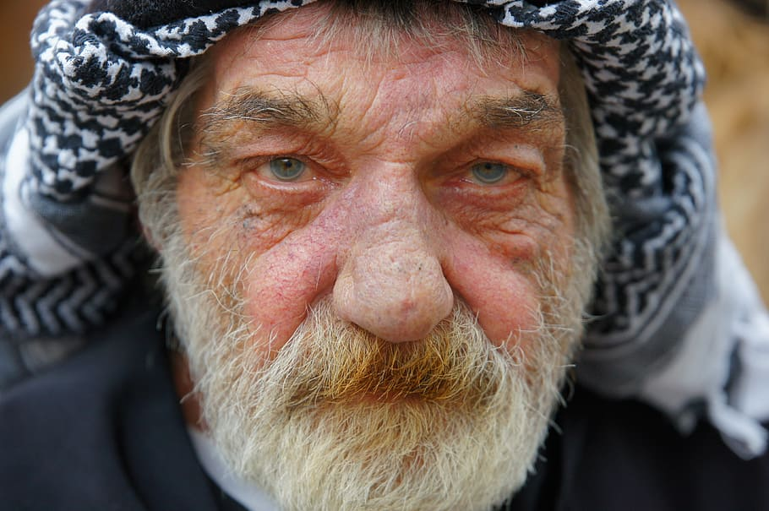
This is Norman Davies. He was recently arrested for child molesting.

Slide 6
ABOUT SCAMMING
One day this can happen to you. You can get a phone call like for example the bank someone can call u and it says the bank and they ask for your bank details but how do you know its a scammer? If they ask you for your information for the bank but the bank all ready have your details!

