Slide 1

Be safe on the internet .

Slide 2

Never go on an app you don't know

Slide 3

Do not talk to some you do not talk to strangers

Slide 4

Talk to some you now. stay safe a stay with your
Friend and family. If you was a youtube it so
Dangerous some people are gelus and some people
Are sad and not happy.

Slide 5

Do not tell so one dellal.

Slide 6

If Iplepep go on scam they and they go

Slide 7

Like roblox it full of people around the universe.

Slide 8

Do not said any to tell you house dres too any one to be safe.

Slide 9

If you don't know how a scam look likes her is a pitcher of a scam

Slide 10
It not good for kids to go on games not for kids

Slide 11
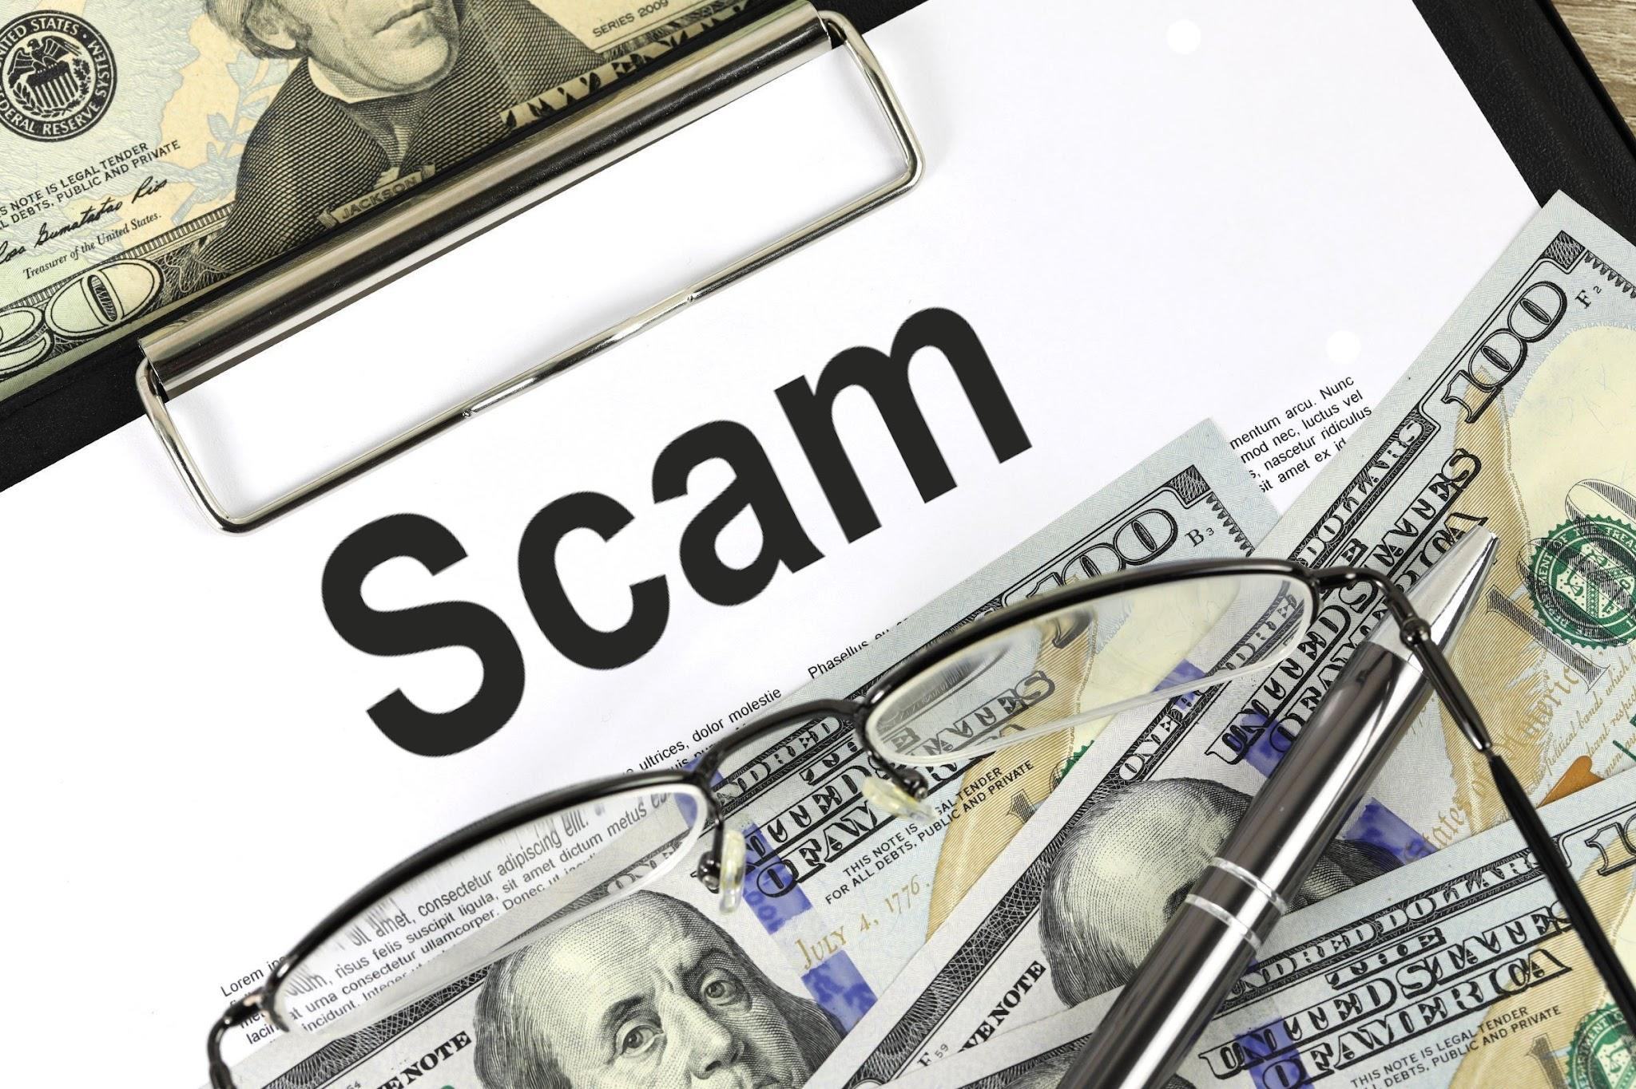
Scams for money. Do not take them

Slide 12

An app you have might has a virus

Slide 13

Facebook you have to be 13

Slide 14

To play fortnite you have to be 13 to play

Slide 15

Which out for scams

Slide 16
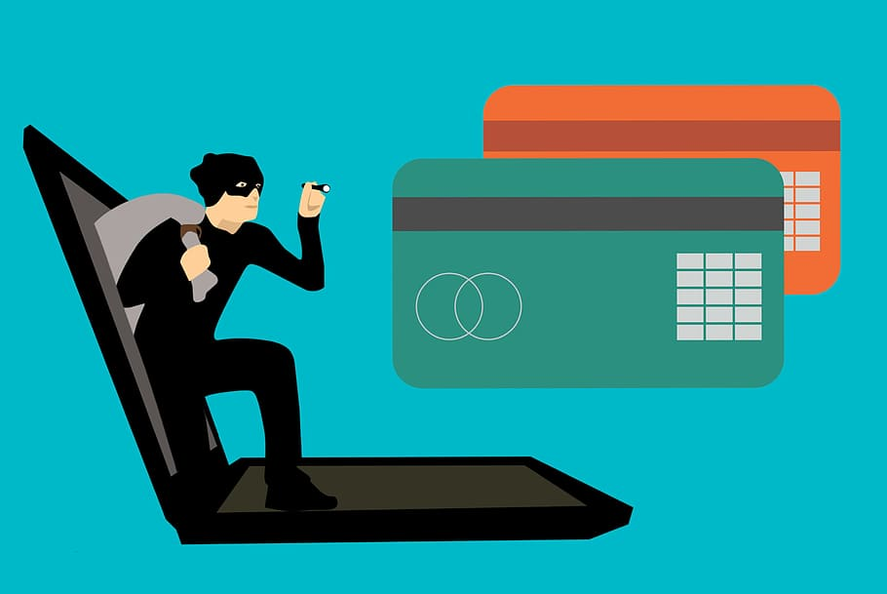
If you don't know people call you for your bank detail hang up

Slide 17

Tell people to stop doing this

Slide 18

Make shor that you be careful from scams

