Slide 1


Slide 2

Downloading Softwares
If you download a software you never heard of,tell parents before you go downloading anything especially if you have to pay for it.

Slide 3
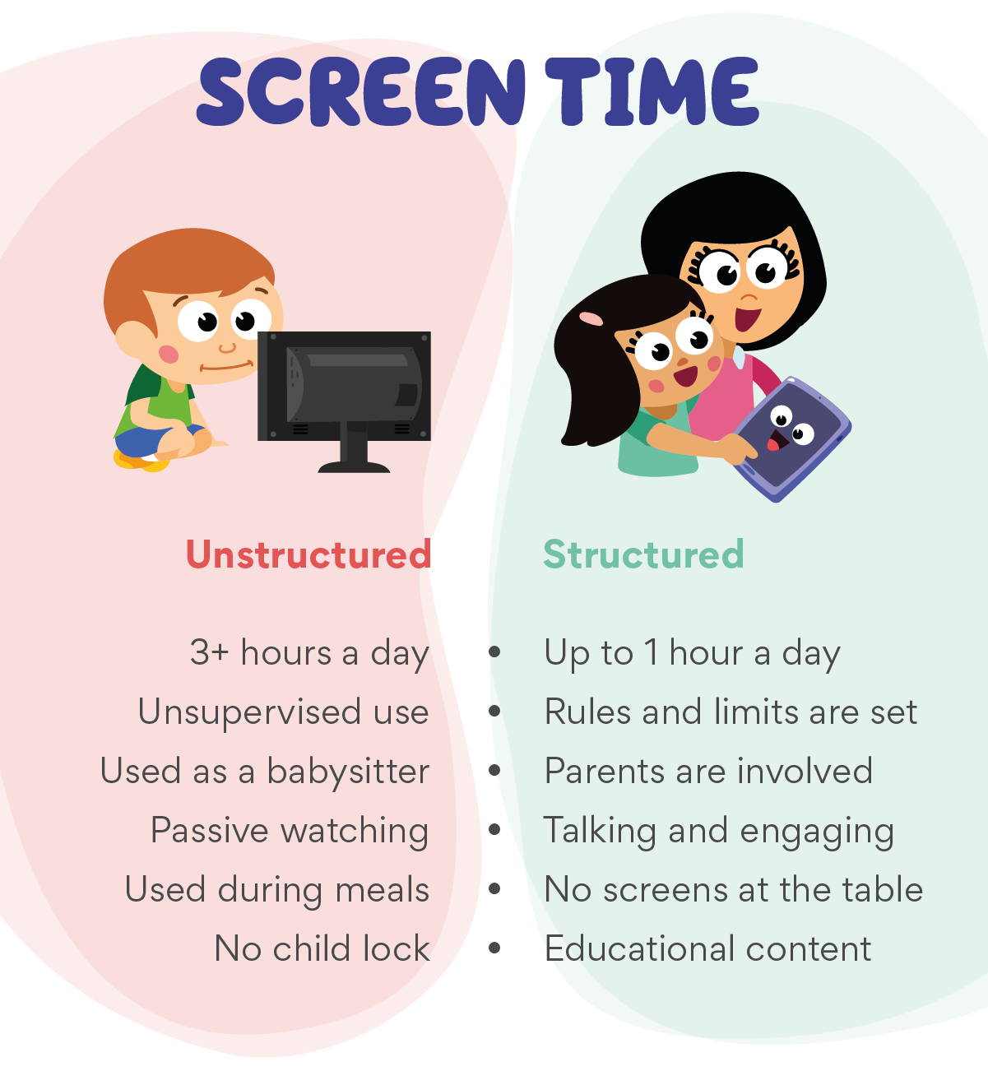
I think that these are the correct facts about kids limited time instead of kids having up to 3+ hours a day they should have around 1-2 hours a day max and get some fresh air.
Globally people get 6 hours 58 minutes screen time per day.

Slide 4


Older people can pretend to be a young person and take control of you and ask you for private information like for your passport and rob you.

Slide 5

When you see these influencers doing really stupid things like jumping off cliffs into water,being mean to people and just stuff like that.
So it makes you wonder that you want to do it because of how fun it looks so just be really careful on who you listen to and who you look up to.
Because you have a potential of getting badly injured and also a chance of fatal death.

Slide 6

Scammers online.
Scammer’s can call you and pretend to be the bank or some else and take you personal information and hack you and ruin your life.

Slide 7

You can help your kids by:
Giving a limited amount of time on kids devices so that they better health and so their eyes got funny. But mostly so that they can get some nice fresh air.

